Slide 1

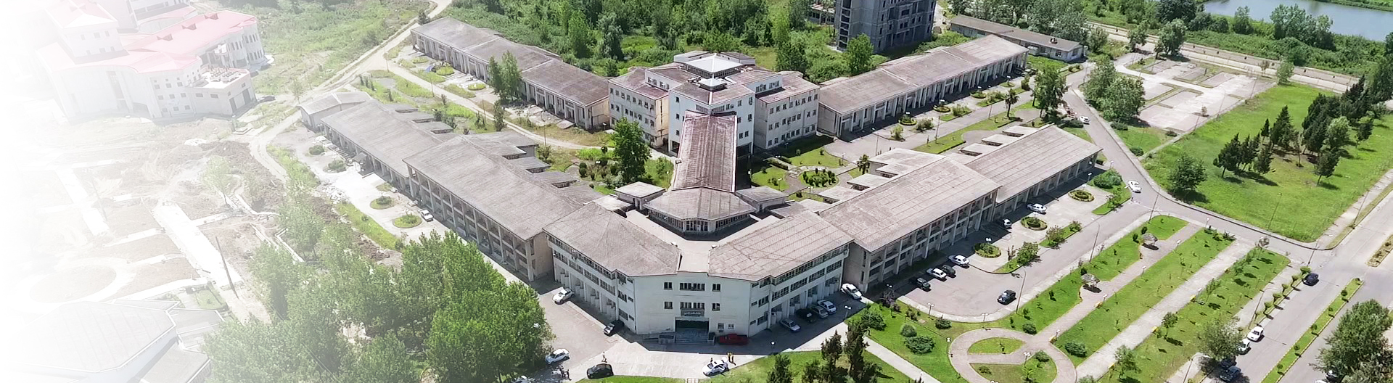
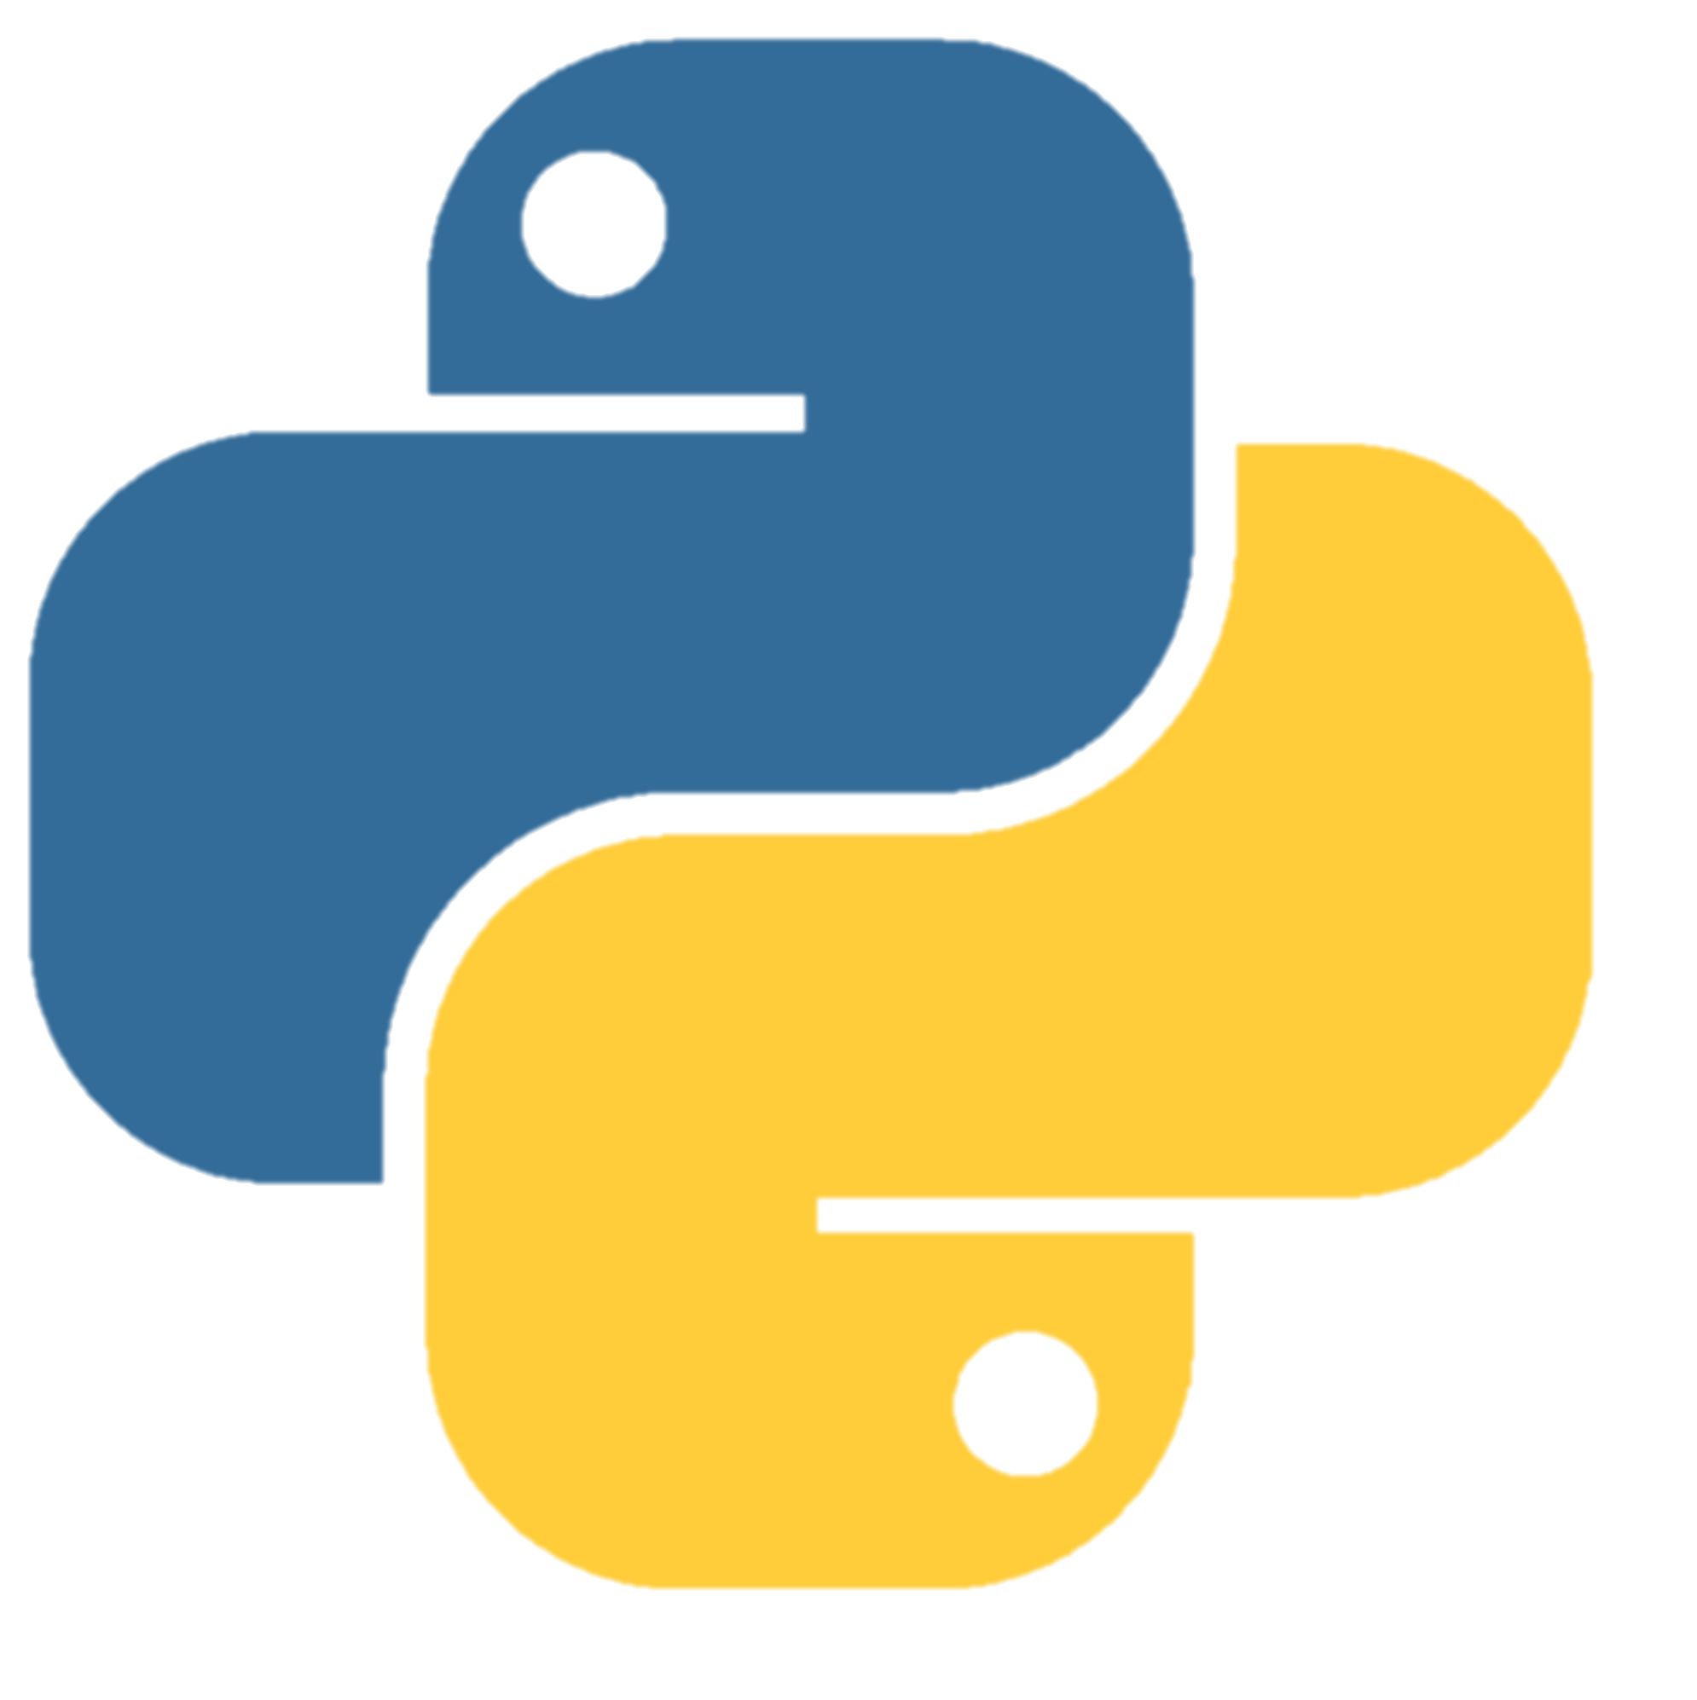
Department of Computer Engineering
Fall-2022 |
Measuring Pdfs Similarity
Pdfs similarity, as the name suggests determines how similar are the two given Pdfs.
In this session, we will discuss:
How to extract the contents of Pdfs.
Introducing a library to check the similarity between contents.
By: Yasaman Golshan - Sara Asadi
Session-4

Slide 2
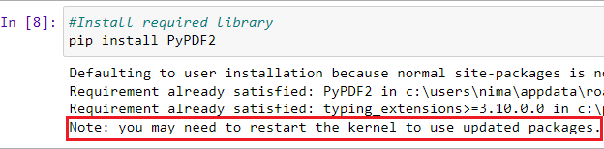
Department of Computer Engineering
Fall-2022 |
Install required library
Install PyPDF2 “ A pure-python PDF library capable of
splitting, merging, cropping, and transforming PDF files”
pip install PyPDF2
Install required library
Session-4

Slide 3

Department of Computer Engineering
Fall-2022 |
Install required library
Import PyPDF2
import PyPDF2 as pd
Import installed library
Session-4

Slide 4

Department of Computer Engineering
Fall-2022 |
Read .pdf files
Use relative address if you saved your .pdf file in directory
To find directory address, type “%pwd”
pdfFileObjec1=open ('1.pdf','rb')
pdfFileObjec2=open ('2.pdf','rb')
“1.pdf ” & “2.pdf ” are the target documents for making the comparison.
Read .pdf files
‘rb’ reads the .pdf file in read binary mode and does not consider other objects like images.
Session-4

Slide 5

Department of Computer Engineering
Fall-2022 |
Creating a .pdf reader object
pdfReader1=pd.PdfReader(pdfFileObjec1)
pdfReader2=pd.PdfReader(pdfFileObjec2)
Create .pdf reader objects
Why We use Objects in Python?
Session-4

Slide 6

Department of Computer Engineering
Fall-2022 |
Creating a page object
pageObj1=pdfReader1.pages[0]
pageObj2=pdfReader2.pages[0]
Create page objects
Session-4

Slide 7

Department of Computer Engineering
Fall-2022 |
Extracting text from page
text1=pageObj1.extract_text()
text2=pageObj2.extract_text()
Extract text from page
Session-4

Slide 8

Department of Computer Engineering
Fall-2022 |
Close the .pdf file object
pdfFileObjec1.close()
pdfFileObjec2.close()
Close .pdf file object
Session-4

Slide 9
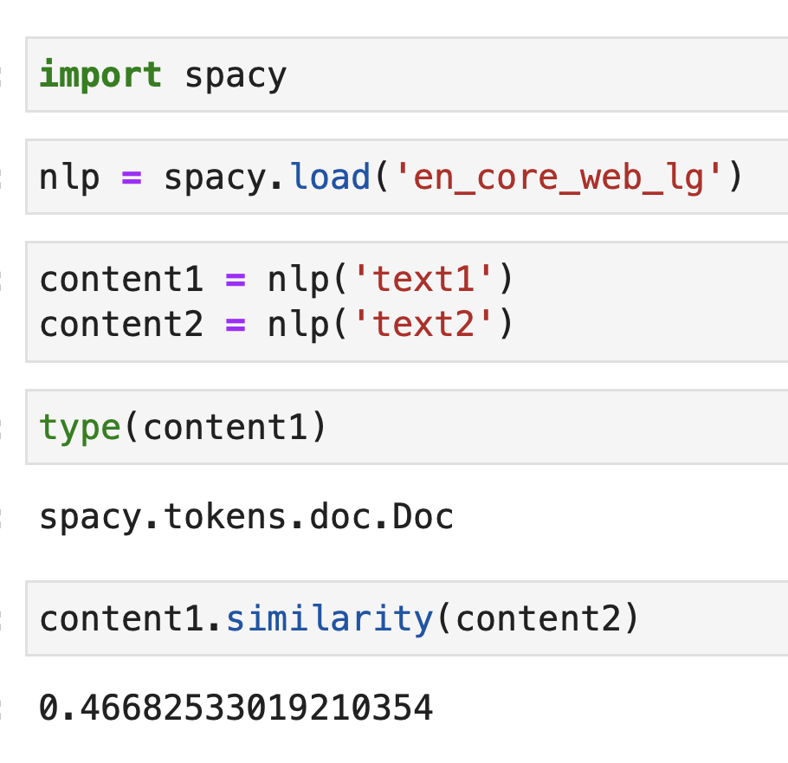
Department of Computer Engineering
Fall-2022 |
Measuring Pdfs Similarity
Import spacy “Spacy is a library for advanced
Natural Language Processing in Python and Cython.
It's built on the very latest research, and was designed from
day one to be used in real products.”
https://spacy.io/
https://bobbyhadz.com/blog/python-the-script-is-installed-in-which-is-not-on-path
spacy.load(“en_core_web_lg”) “English is chosen as its language model.”
The output would be a number between -1 and 1.
Session-4

Slide 10
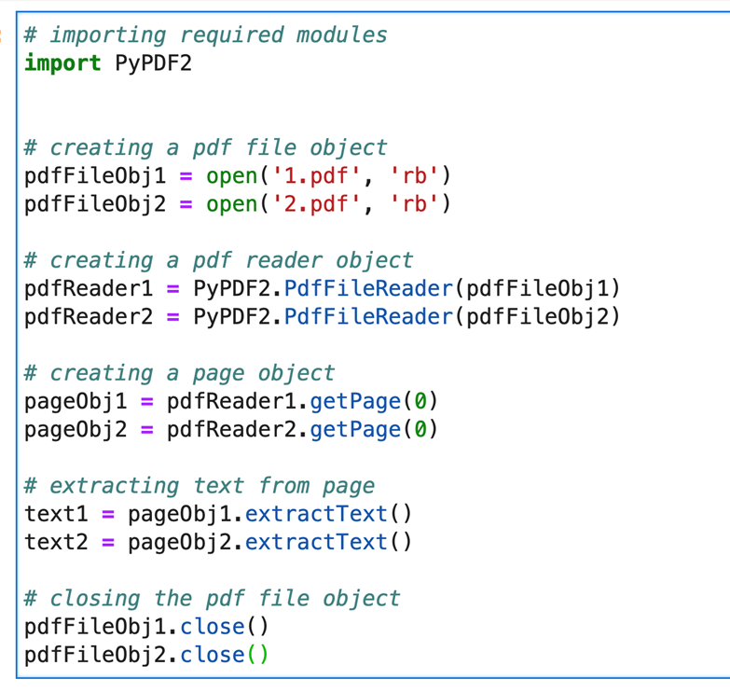
Department of Computer Engineering
Fall-2022 |
Measuring Pdfs Similarity
Session-4

Slide 11

Department of Computer Engineering
Fall-2022 |
11
Questions?
Session-4

